Slide 1
Name | Cameron
Git Hash | 0df3249a3ba0853b8c291e061eccfbd9fc56a0b3
Sprint number | Start date | end date | Work hard rating
3 | 2/5/22 | 27/5/22 | 2/5

Slide 2
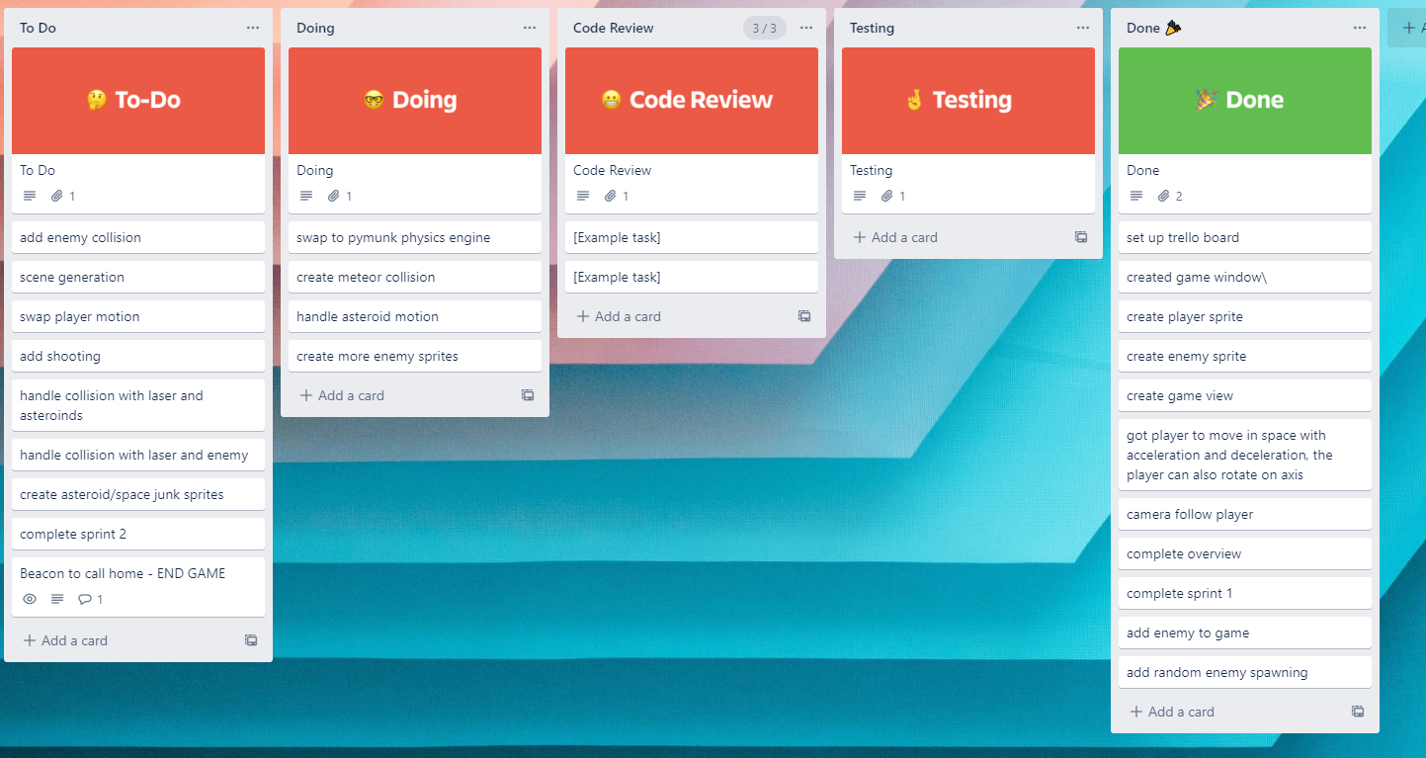
KANBAN board at the start of the sprint

Slide 3
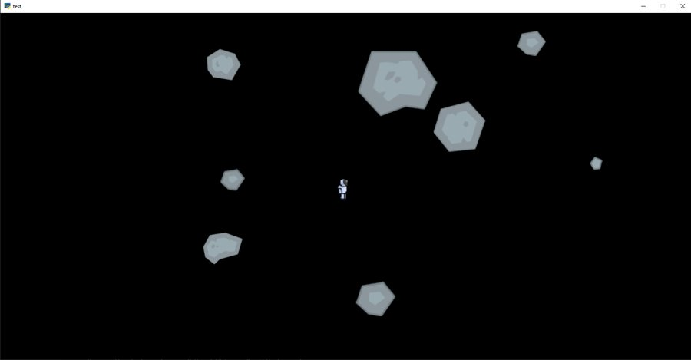
Screenshot of the game at the start of the sprint

Slide 4
Sprint Reflection and summary
Finished enemy spawning
Created meteor sprites
Meteors spawn with similar code to enemies
Mostly finished enemy ai
Started implementing physics engine

Slide 5
Briefly describe other team members contributions
James was focusing on the physics engine

Slide 6
Major Changes and Achievements Described
The spawning of enemies is done
Enemy ai works for one enemy but not multiple
Physics engine isn't done but James' understanding is better

Slide 7
Brief Description of your testing
I created a file within the repository to test the ai
I would get input from James, Mr ward and other people in the class

Slide 8
Link to testing results/tables
There are no results tables but the results allowed me to fine tune paramters for the ai

Slide 9
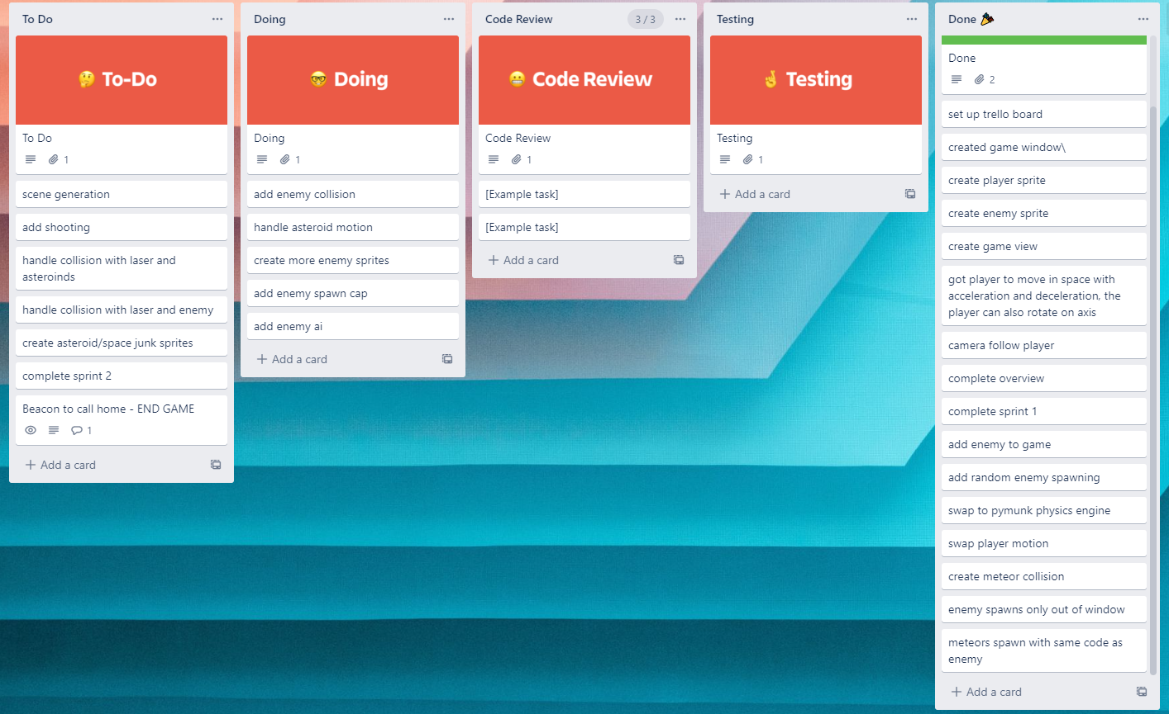
KANBAN board at the end of the sprint

Slide 10
Screenshot of the game at the end of the sprint

Slide 11
Video of the game at the end of the sprint

Slide 12
Notes for next time, future improvements
I need to finish the ai so it works with multiple enemies
Both I didnt get as much work as i would want and james struggled with the physics engine so our overall work wasn't very good so i merged 2 sprints

